Slide 1
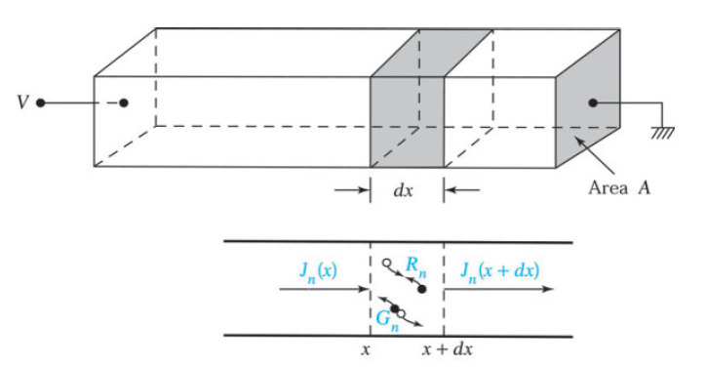
CONTINUITY EQUATION
In the previous sections we considered individual effects such as drift due to an electric field, diffusion due to a concentration gradient, and recombination of carriers through intermediate-level recombination centers. We now consider the overall effect when drift, diffusion, and recombination occur simultaneously in a semiconductor material. The governing equation is called the continuity equation.
Dr. S. RANJITH / Physics, SRM IST

Slide 2



To derive the one-dimensional continuity equation for electrons, consider an infinitesimal slice with thickness dx located at x. The number of electrons in the slice may increase due to the net current flow into the slice and the net carrier generation in the slice. The overall rate of electron increase is the algebraic sum of four components: the number of electrons flowing into the slice at x, minus the number of electrons flowing out at x + dx, plus the rate at which electrons are generated, minus the rate at which they are recombined with holes in the slice.
The first two components are found by dividing the currents at each side of the slice by the charge of an
electron. The generation and recombination rates are designated by Gn and Rn , respectively. The overall rate of change in the number of electrons in the slice is then
where A is the cross-sectional area and Adx is the volume of the slice. Expanding the expression for the current at x + dx in Taylor series yields
We thus obtain the basic continuity equation for electrons:
Dr. S. RANJITH / Physics, SRM IST

Slide 3

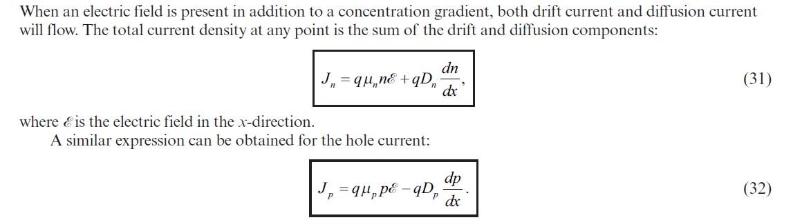
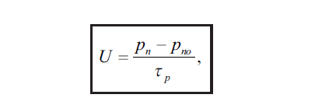
A similar continuity equation can be derived for holes, except that the sign of the first term on the right-hand side of Eq is changed because of the positive charge associated with a hole:
We can substitute the current expressions from Eqs. 31 and 32 and the recombination expressions from Eq. 43 into Eqs. 57 and 58. For the one-dimensional case under low-injection condition, the continuity equations for minority carriers (i.e., np in a p-type semiconductor or pn in an n-type semiconductor) are
Dr. S. RANJITH / Physics, SRM IST

Slide 4
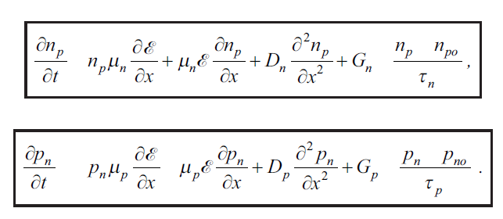
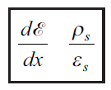
In addition to the continuity equation, Poisson’s equation
must be satisfied, where ε_{S} is the semiconductor dielectric permittivity and ρ_{s} is the space charge density given by the algebraic sum of the charge carrier densities and the ionized impurity concentrations, q (p – n + N⁺_{D} – N⁻_{A}).
Dr. S. RANJITH / Physics, SRM IST

